Slide 1
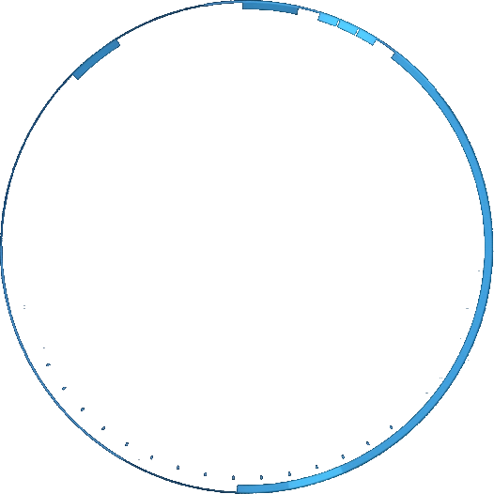

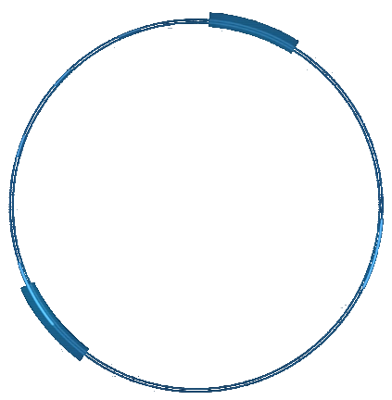





Iteration II
4 amigos
Group members:
Yangzekun Gao
Jingke Shi
Zhengyan Hu
Maiqi Hou

Slide 2
Catalog
1
Project Vision
2
Design diagrams
3
GRASP
Test coverage plan
4
Gantt / Time-Card / Issue tracking
5

Slide 3
01
Project Vision
An application with accounting function. It provides add records and view records two features
Add: add new expenses or income records
View: view historical records

Slide 4
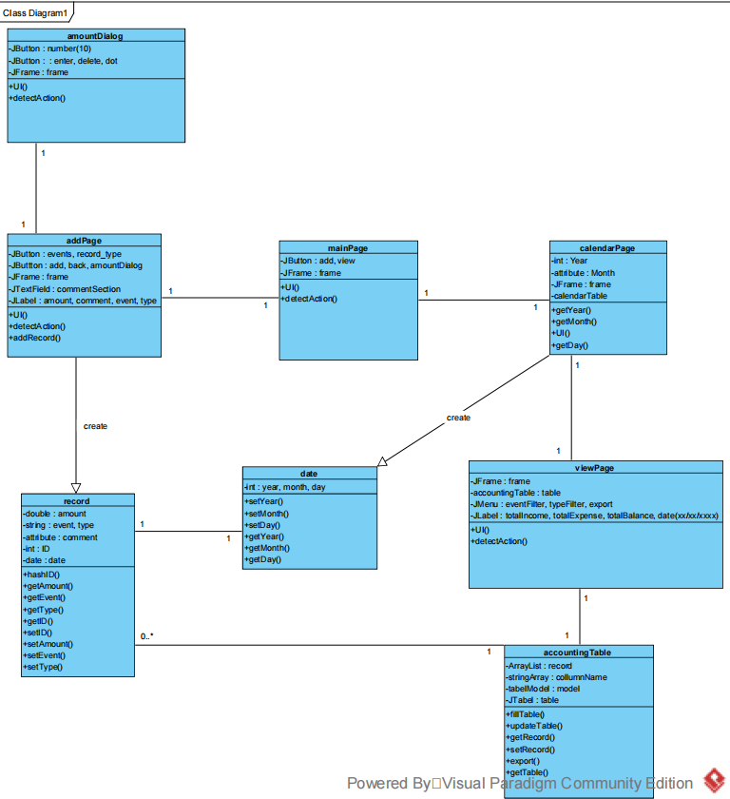
02
Design diagrams
Class diagram

Slide 5
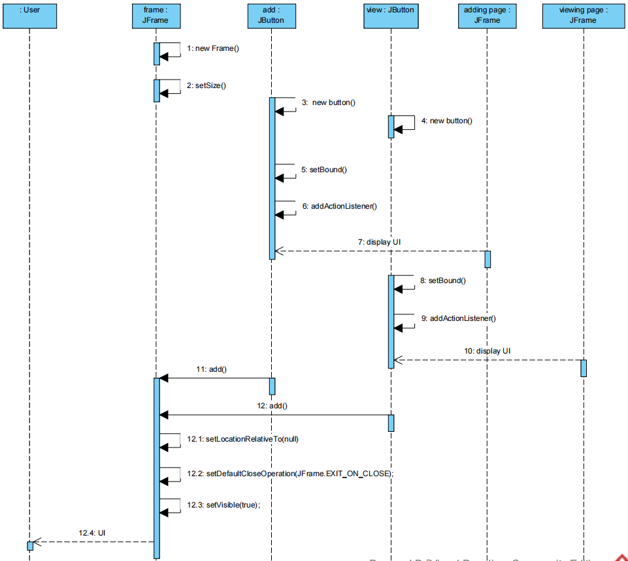
02
Design diagrams
Main Page Selection SSD
Main Page Selection SSD

Slide 6
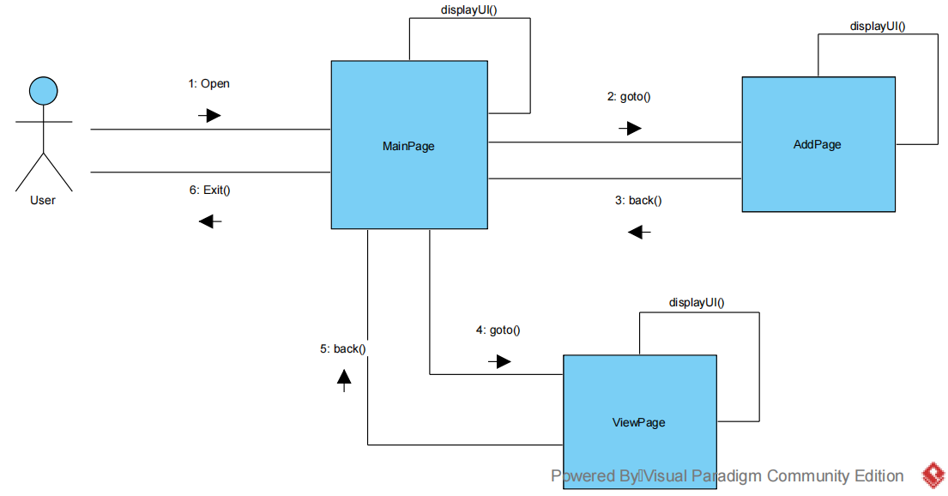
02
Design diagrams
Communication diagrams
Main Page Selection

Slide 7
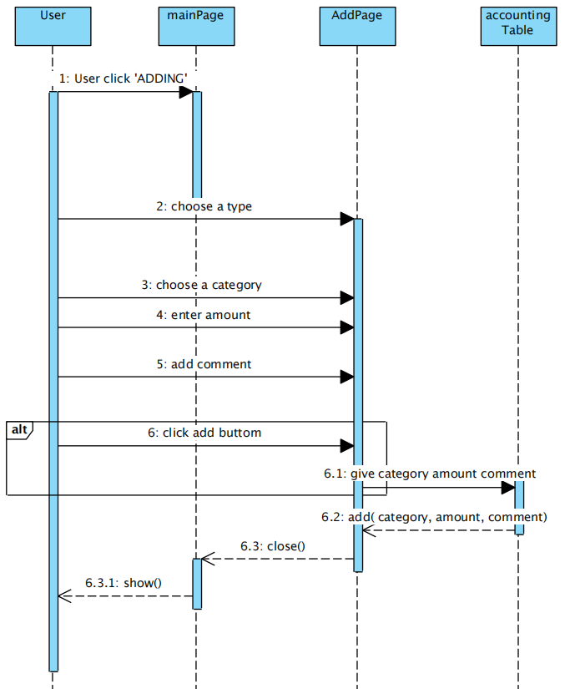
02
Design diagrams
add record from add page SSD

Slide 8
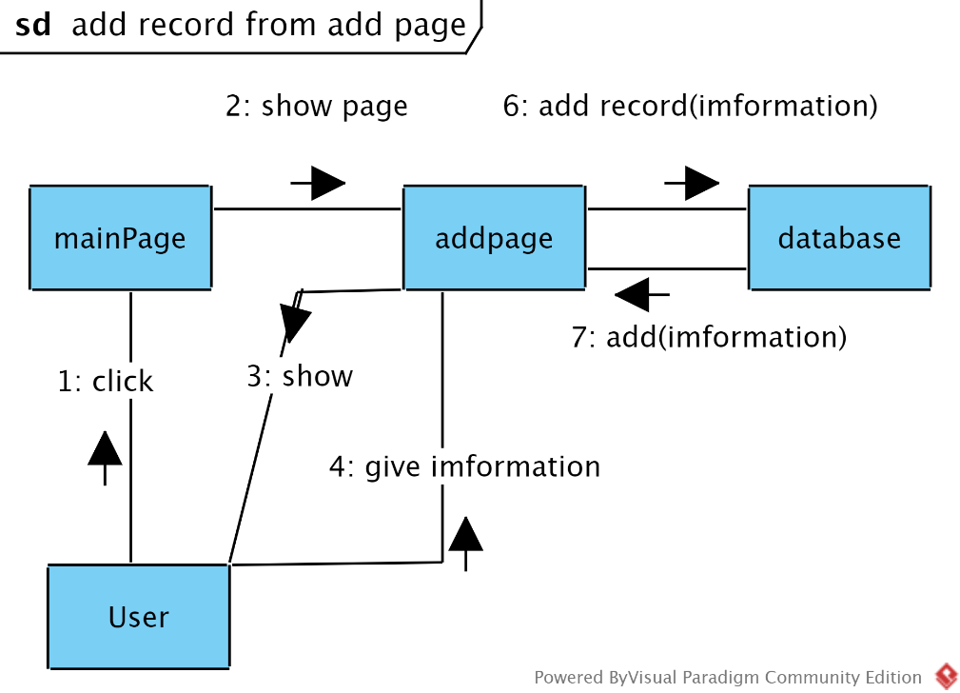
02
Design diagrams
Communication diagrams
add record from add page

Slide 9
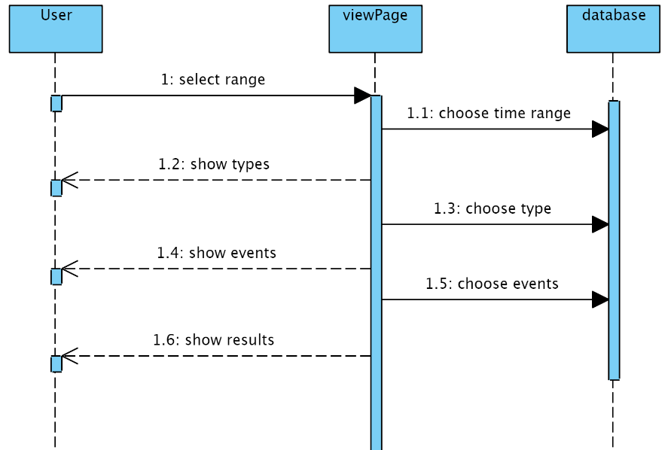
02
Design diagrams
View Range SSD

Slide 10
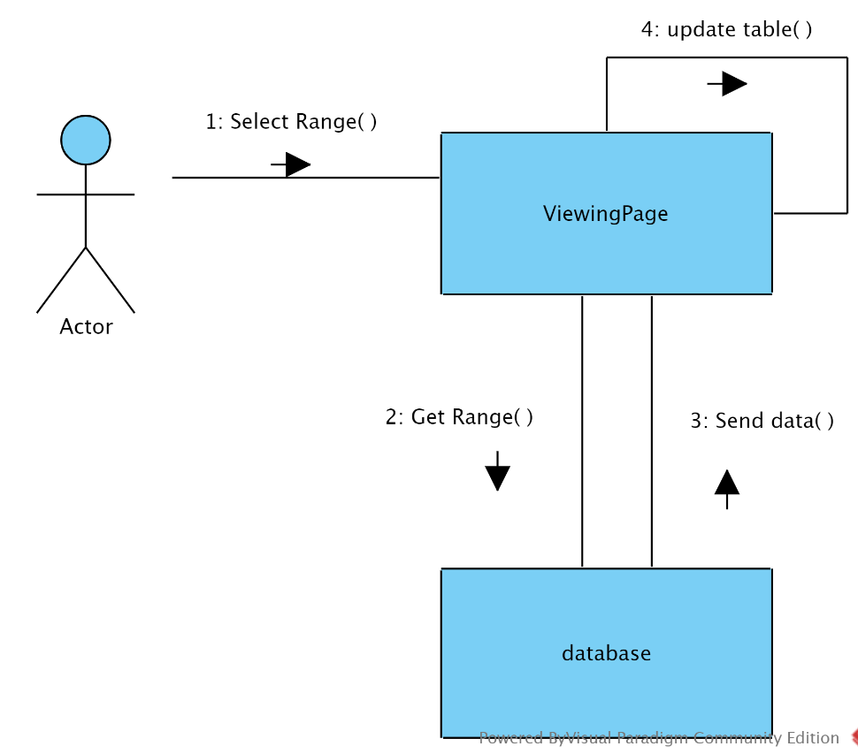
02
Design diagrams
Communication diagrams
View Range

Slide 11
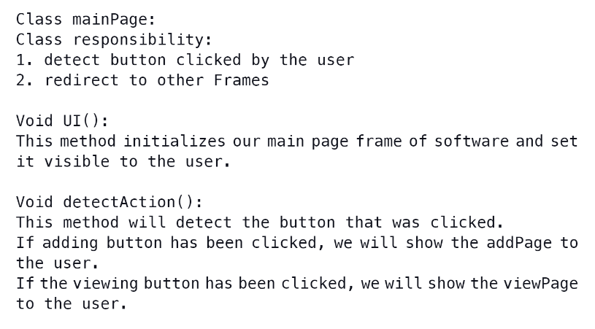
03
GRASP

Slide 12
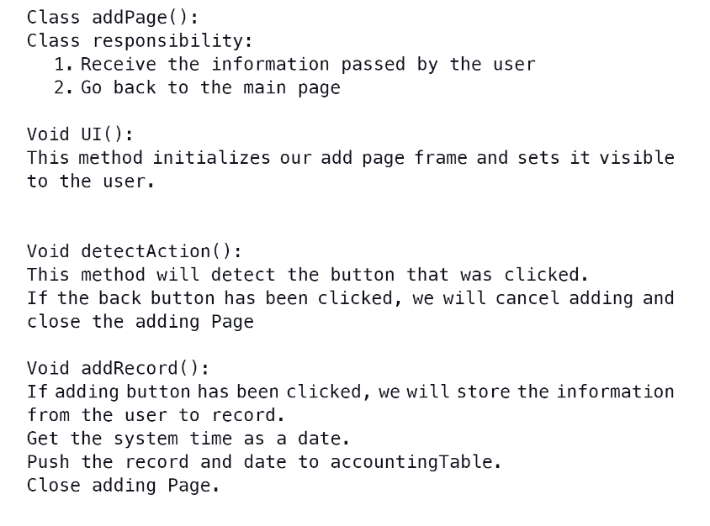
03
GRASP

Slide 13
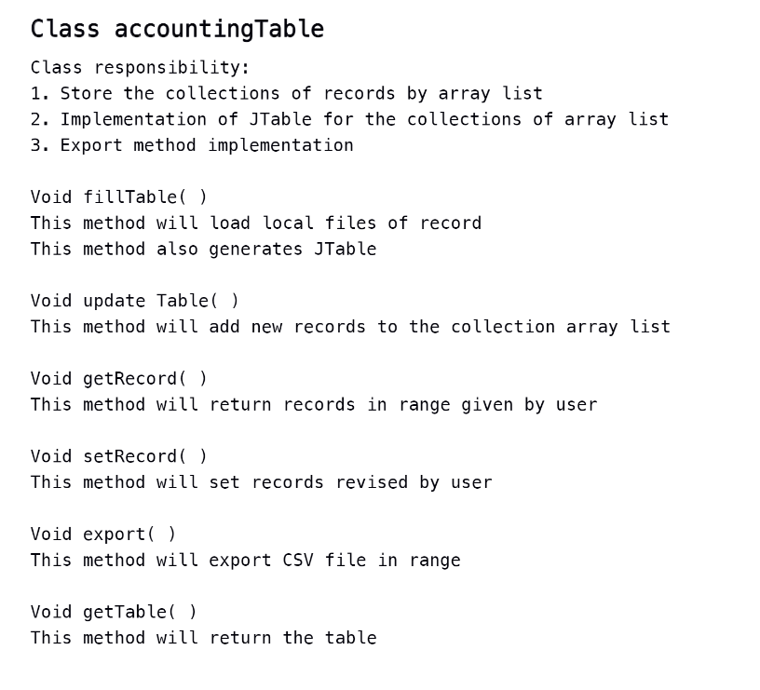
03
GRASP

Slide 14
04
Test coverage plan
1. Main page
(1) Every button work properly
(2) Can work on different computer system
(3) Link to other frame properly
(4) Close and display properly
3. choose data page
(1) Every button work properly
(2) Can work on different computer system
(3) Link to other frame properly
(4) Close and show display properly
(5) Calendar work properly
(6) Get date
(7) sent date for determining the range of display
2.Add page
(1) Every button work properly
(2) Can work on different computer system
(3) Link to other frame properly
(4) Close and display properly
(5) Get record type
(6) Get record event
(6) Edit amount dialog work properly
(7) Get amount
(8) Get comment
(9) Store record to database
4. view Page
(1) Every button work properly
(2) Can work on different computer system
(3) Link to other frame properly
(4) Close and show display properly
(5) Event filter work properly
(6) Type filter work properly
(7) Table information is correct
(8) Edit records
(9) Delete records

Slide 15
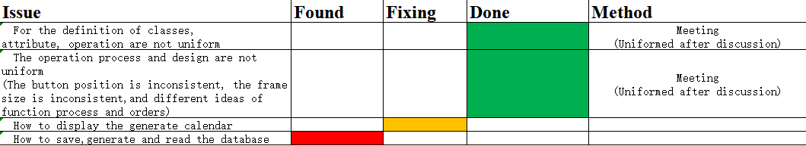
05
Gantt / Time-Card / Issue tracking
Meetings:
Sunday, October 24, 2018 (5 PM – 7 PM)
Wednesday, October 27, 2018 (1:25 PM – 6 PM)
Individual Hours:
Yangzekun Gao: 10 + 9.25 = 19.25 hrs.
Maiqi Hou: 9 + 8.75 = 17.75hrs.
Jingke Shi: 9+ 8.0 = 17 hrs.
Zhengyan Hu: 9 + 7.25 = 16.25 hrs.
Issue tracking

Slide 16
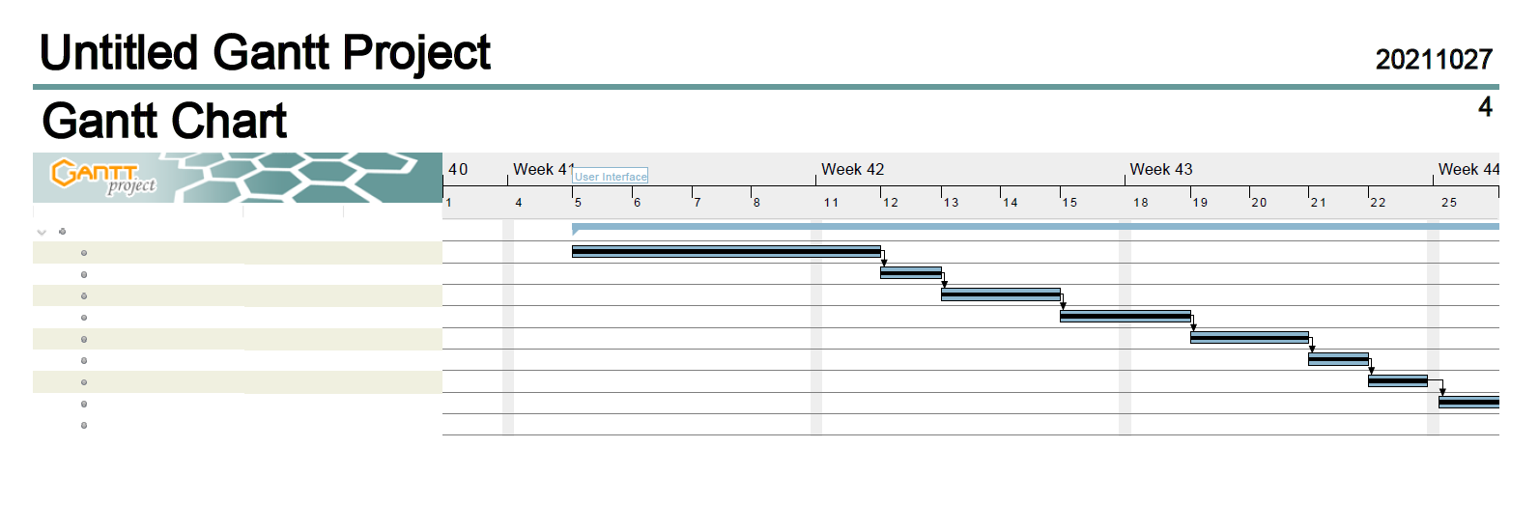
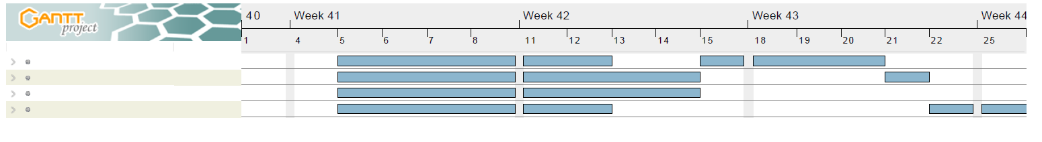
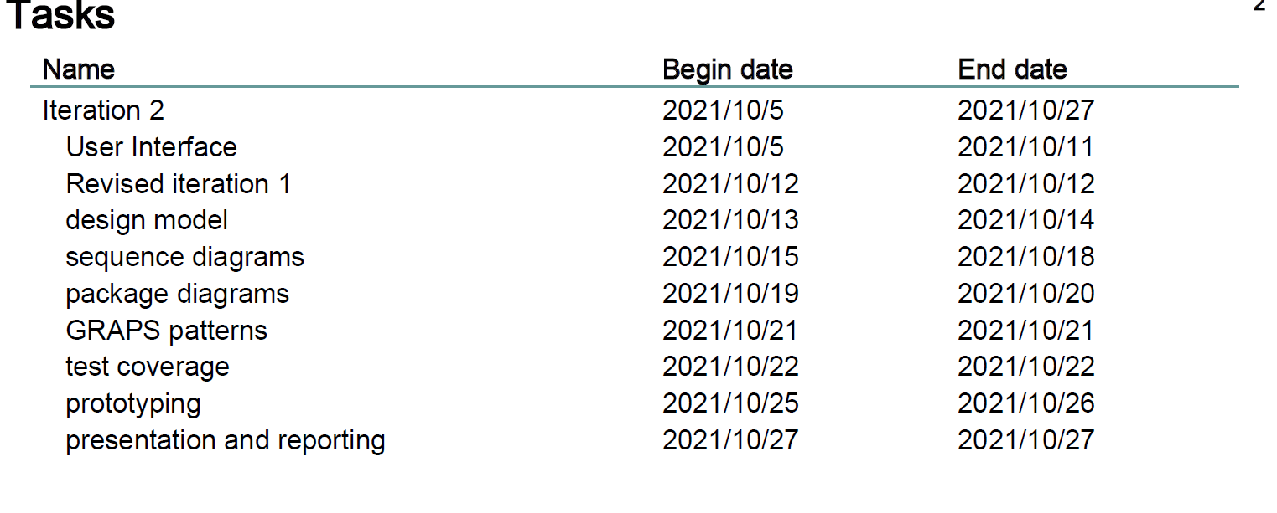
05
Gantt / Time-Card / Issue tracking

Slide 17
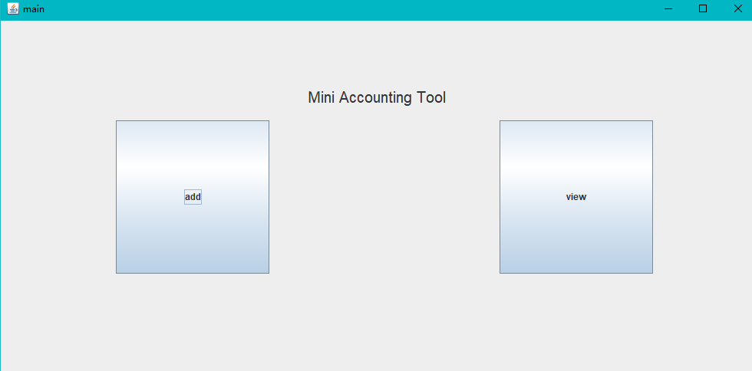
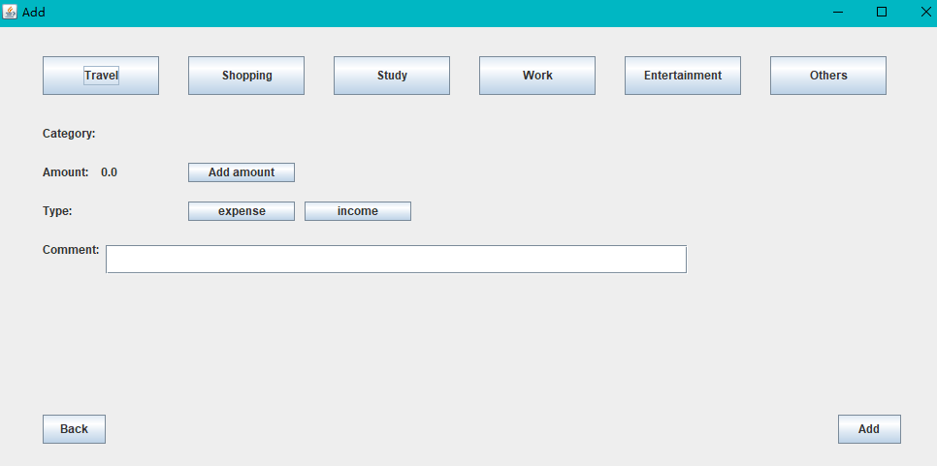
UI Demo
The Main Page
A customer can add an accounting records or view previous records
The Add Page
A customer can choose a category, amount , type and comment of accounting records

Slide 18
Iteration II
Thank you

